Slide 1

Big Data Project: Mortality Dataset
Kevin Anani, Lorenzo Bartolini, Latifat Braimah, John Miller, Gaurav Sing, and Ngoc-Quyen Vu
Prof. Gao
BUDT758B

Slide 2

U.S. Mortality Dataset
Data Storage: Merged Data (MySQL), Dumped as CSV file and Uploaded AWS-Sagemaker and Databricks
Data Visualization: PySpark on Databricks
Machine Learning: Logistic Regression using PySpark
Data: CDC Dataset (2005-2015)
Notes:
Data Storage: Merged Data (MySQL), Dumped as CSV file and Uploaded AWS-Sagemaker and Databricks
Data Visualization: PySpark on Databricks
Machine Learning:

Slide 3

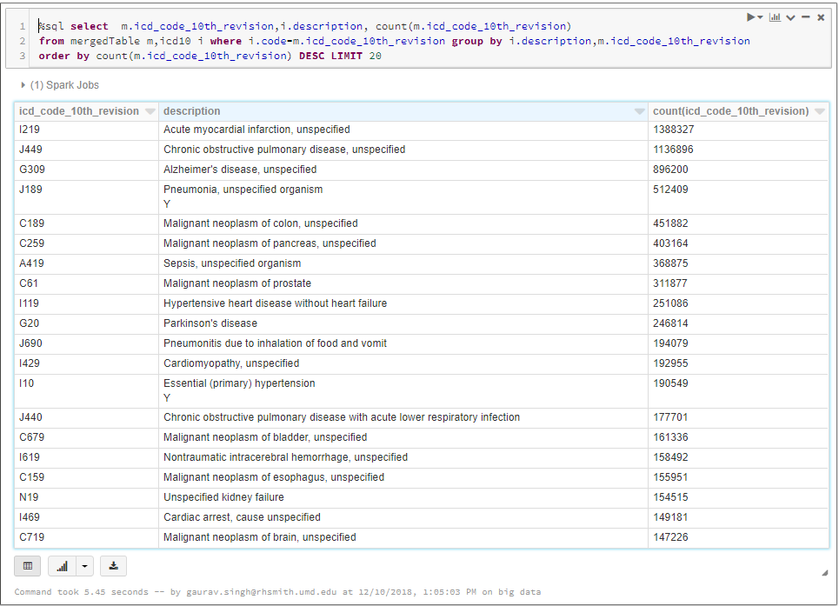
\
Top 20 Causes of Death (Diseases)

Slide 4
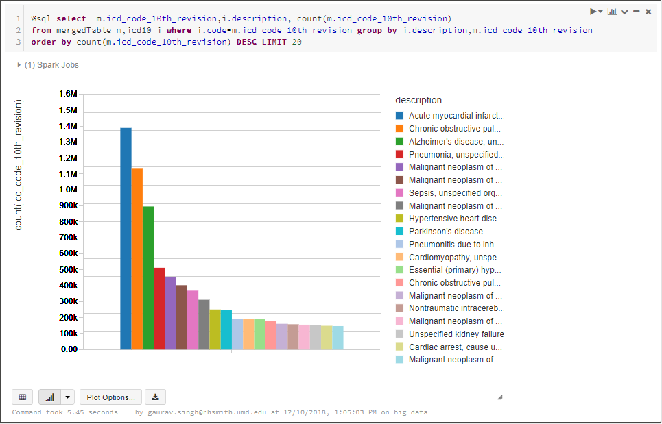
Top 20 Causes of Death (Diseases)

Slide 5

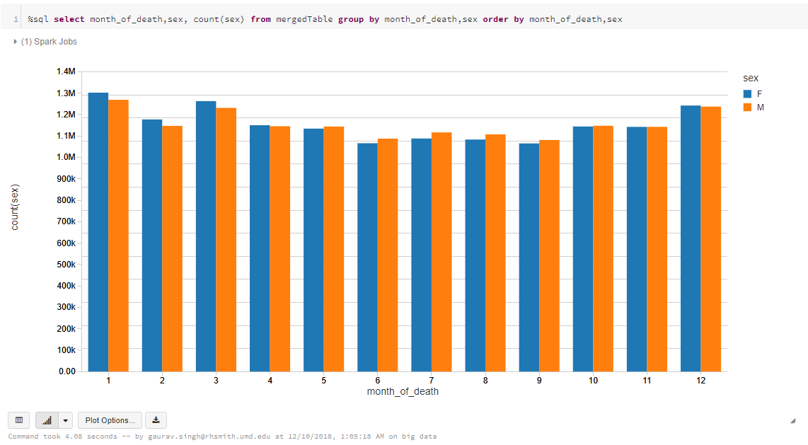
Male VS. Female Death rates per month

Slide 6
Male VS. Female Death rates per month
Summer Months: Death Count for Males is Higher
Winter Months: Death Count for Females is Higher

Slide 7

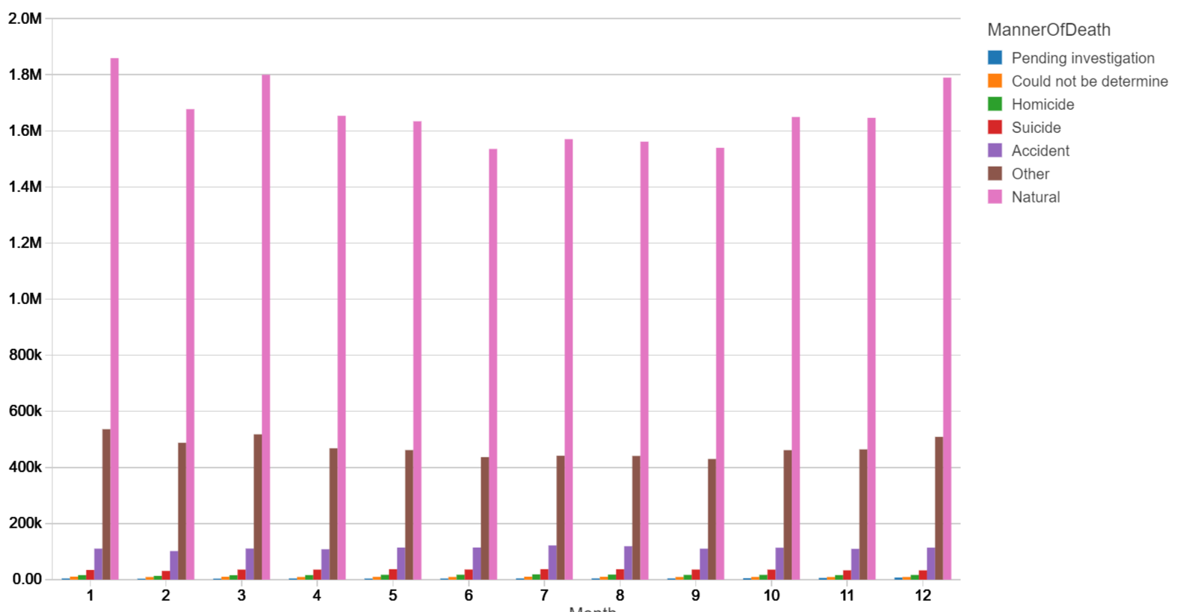
Manner of Death per Month
Maximum Deaths each Month due to Natural Causes
Winter Months are the deadliest

Slide 8
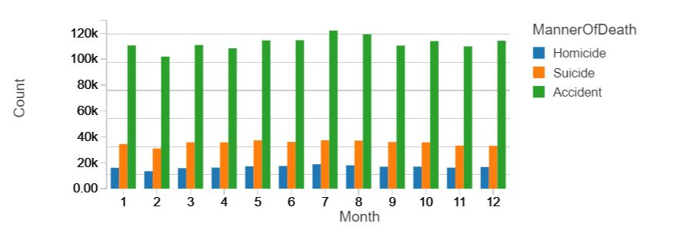
Manner of Death per Month
Highest Number of Homicides Committed in the Month of July

Slide 9
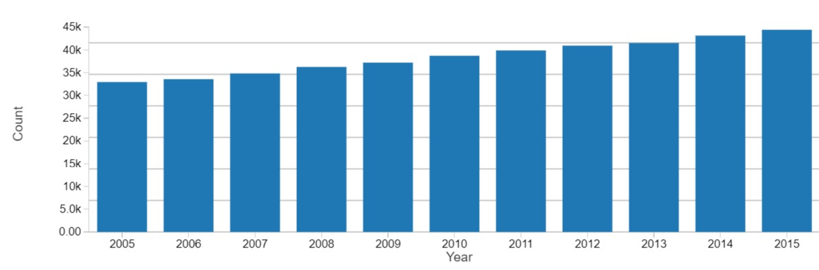
Total Suicides Committed 2005-2015
Uniform rise in total number of suicides committed per year

Slide 10

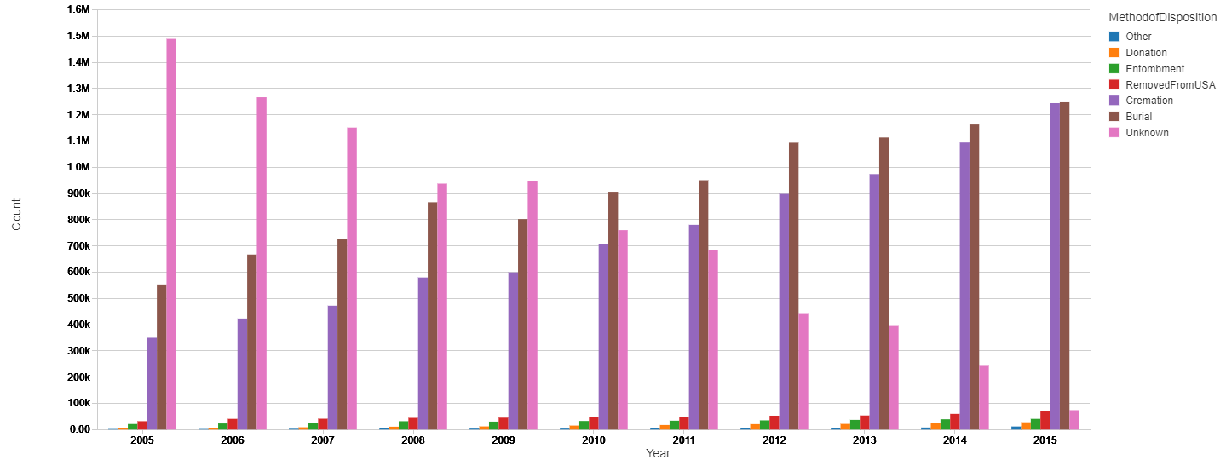
Methods of Disposition per Year

Slide 11
Methods of Disposition per Year
Steady Rise in Rate of Cremation
Factors:
Consumer Cost considerations
Fewer Religious Prohibitions
Changing Consumer Preferences
Notes:
Cremation cost less than 1/5 of funerals with burial

Slide 12

Predicting Burial vs Cremation
Aim: Predict if a person is to be cremated or buried based on important characteristics (such as sex, age, race, marital status, manner of death)
Model used: Logistic Burial
Package: pyspark.ml
Used Databricks
Pipeline:
String Indexing
One Hot encoding
Vector Assembling

Slide 13
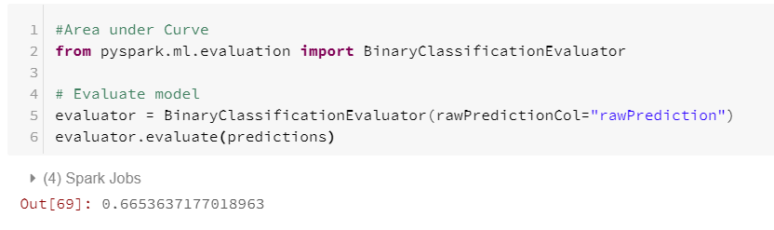
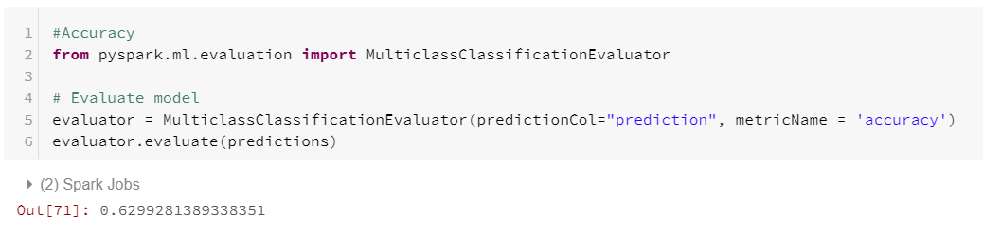
Model Accuracy

Slide 14

Thank You!

